Slide 1
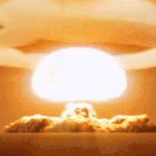

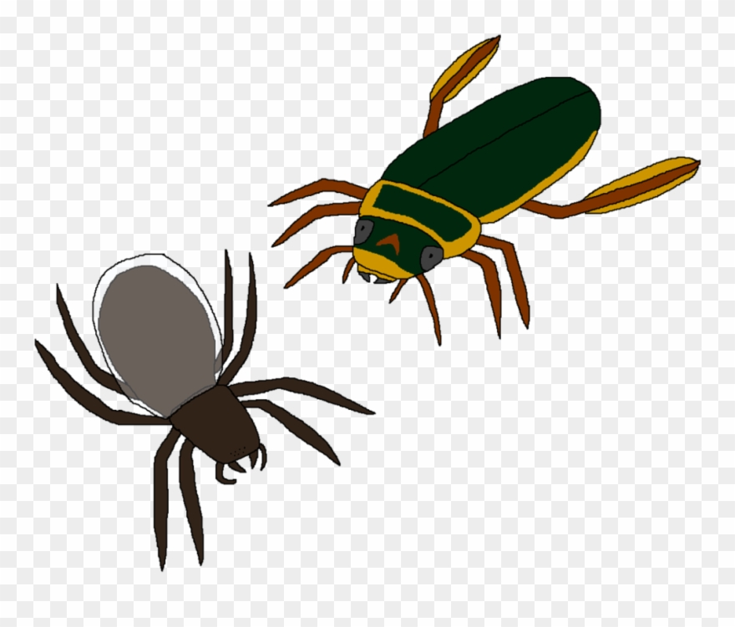




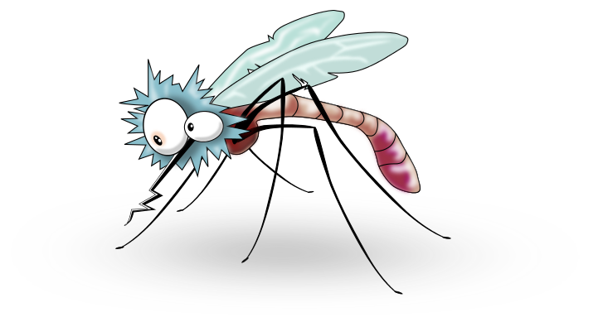



Slide 2

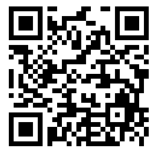



Efficient and Scalable Thread-Safety-Violation Detection
Finding thousands of concurrency bugs during testing
Guangpu Li, Shan Lu, Madanlal Musuvathi, Suman Nath, Rohan Padhye

Slide 3

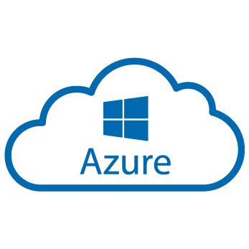








Concurrent programs are everywhere

Slide 4


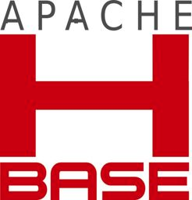
Concurrency bugs are everywhere
MySQL / MYSQL-791
“I think it is too complicated and too risky!”
Hadoop Map/Reduce / MAPREDUCE-4819
“This has become quite messy, sigh.”
Hadoop Map/Reduce / MAPREDUCE-3274
“That is one monster of a race!”
HBase / HBASE-4397
“Do we have to rethink this entire [HBase] …There isn’t a week going by without some new bugs about races?.”

Slide 5
Concurrency bugs are everywhere
MySQL / MYSQL-791
“I think it is too complicated and too risky!”
Hadoop Map/Reduce / MAPREDUCE-3634
HBase / HBASE-6417
“we [prefer] debugging crashes instead of hard-to-track hanging jobs.”
Hadoop Map/Reduce / MAPREDUCE-4819
“We has already found and fix many case,
however it seems exist many other cases all the same.”
“This has become quite messy, sigh.”
Hadoop Map/Reduce / MAPREDUCE-3274
HBase / HBASE-6060
“That is one monster of a race!”
Hadoop Map/Reduce / MAPREDUCE-4099
This issue, and the other related issues ... makes me very nervous about all the state combinations
“Great catch, Sid! Apologies for missing the race condition.”
HBase / HBASE-4397
“Do we have to rethink this entire [HBase] …There isn’t a week going by without some new bugs about races?.”

Slide 6

Thread-safety violation (TSV)
Thread-safety contract
class MyClass{
public: m1();
m2();
...
}
m1 // m1
m1 // m2
Thread-safety violation
myObj.m1()
myObj.m2()
thread 1
thread 2

Slide 7
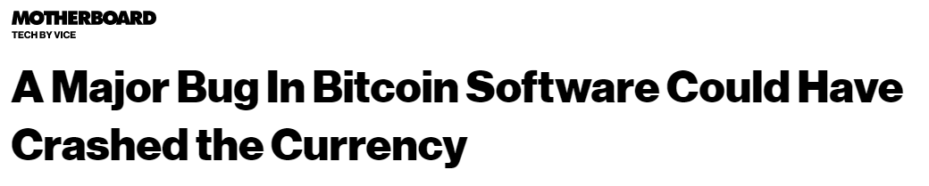
Thread-safety violation example
Class List {
public:
Add(...);
Get(...);
...
}
Thread-safety contract
class MyClass{
public: m1();
m2();
...
}
m1 // m1
m1 // m2
Add // Add
Thread-safety violation
mylist.Add(x)
mylist.Add(y)
myObj.m1()
myObj.m2()
thread 1
thread 2
thread 1
thread 2

Slide 8

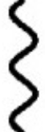
Reasoning about TSVs is difficult (I)
too many possibilities of concurrency
Multithreading
Event-driven
Message passing

Slide 9
Reasoning about TSVs is difficult (II)
too many forms of synchronizations
lock.Lock()
Obj.notify()
RPC_wait()
semaphore.Require()
pthread_mutex_lock()
While(flag != 1){}
Obj.wait()
Obj.signal()
Event.WaitOne()
Thead.join()
synchronized{…}
monitor.tryenter()
monitor.exit()
RPC_wait()

Slide 10





In small scale, it is fine.
Program source code
Integration
Static data-race analysis
Pruning
~1 out of 5
Test Inputs
Program
binary
Integration
Dynamic data-race analysis
Pruning
~10x[1]
~1 out of 2
[1]"FastTrack: efficient and precise dynamic race detection." PLDI 2009.

Slide 11


In large scale, it is NOT fine.
CloudBuild: 100M tests from 4K teams, up to 10K machines /day
Tests inputs
Program
binary
Integration
Dynamic data-race analysis
Pruning
10x
x10
Notes:
.

Slide 12
Three challenges
Integration
Overhead
False positives

Slide 13

TSVD
A scalable dynamic analysis tool for TSVs:
Test inputs
Dynamic analysis
Program
binary
Integration
Testing run
Pruning
TSVD
*1134 >> others
Thread-safety
contracts
Push-button
30% overhead
0 false positive

Slide 14
TSVD
Motivation
TSVD design
Evaluation
Conclusion

Slide 15

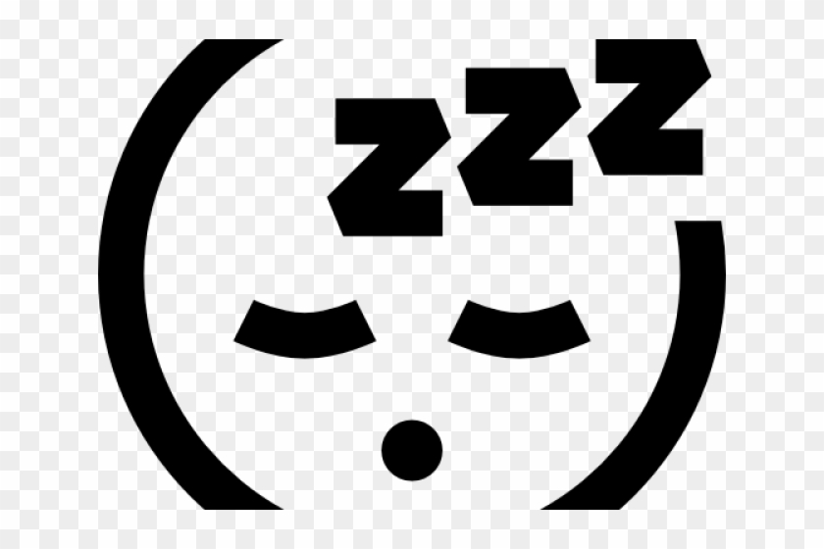
How to achieve zero false positive?
Report after violation
+ inject delays to trigger violations
mylist.Add(x)
mylist.Add(x)
mylist.Add(x)
mylist.Add(y)
thread 1
thread 2

Slide 16
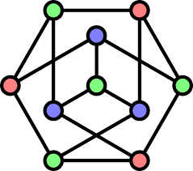
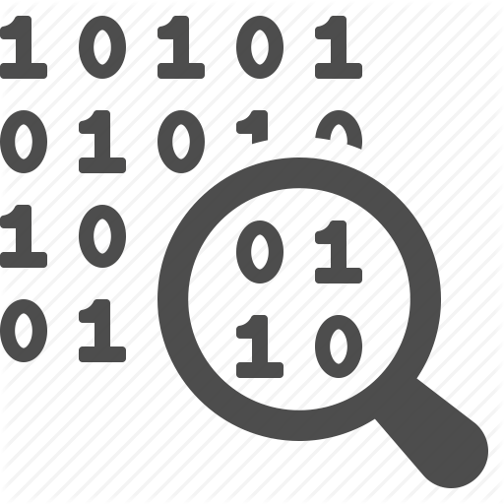
What are potential unsafe calls?
Happen-Before analysis
lock.Lock()
Obj.wait()
Obj.signal()
Cost of delay
monitor.exit()
Every call
Every racing call
[DataCollider, …]
[RaceFuzzer, …]
0
Cost of identification

Slide 17
What are potential unsafe calls?
Every call
[DataCollider, …]
Every likely racing call
Cost of delay
TSVD
Every racing call
[RaceFuzzer, …]
0
Cost of identification

Slide 18

Racing Calls
likely
Two conflict methods
Called from different threads
Accessing the same object
having concurrent logical timestamps
mylist.Add(y)
mylist.Add(z)
thread 1
thread 2
lock.Lock()
Obj.wait()
close-by physical
Obj.signal()
monitor.exit()

Slide 19
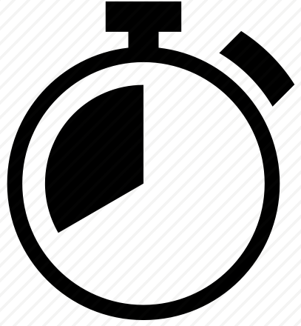
Identify likely race calls
mylist.Add(x)
likely racing list
mylist.Add(y)
Operation1 | Opeartion2
mylist.add(x) | mylist.add(y)
mylist.Add(x)
mylist.Add(y)
thread 1
thread 2

Slide 20
Remove unlikely race calls
Lock()
mylist.Add(x)
Unlock()
Lock()
likely racing list
mylist.Add(y)
Operation1 | Opeartion2
mylist.add(x) | mylist.add(y)
Unlock()
Lock()
mylist.Add(x)
Loop
Unlock()
Lock()
thread 1
mylist.Add(y)

Slide 21


Insights for synchronization analysis inference
Many ways to implement synchronization:
Obj.wait()
While(flag != 1){}
lock.Lock()
RPC_wait()
Thead.join()
One common effect of all synchronizations:
If m1 synchronized before m2 and m1—m2 are nearby
delay to m1 will cause delay to m2

Slide 22
Synchronization inference: transitive delay
mylist.Add(x)
likely racing list
Operation1 | Opeartion2
mylist.add(x) | mylist.add(y)
No-progress
Unlock()
Any synchronizations
Lock()
mylist.Add(y)
thread 1
thread 2

Slide 23
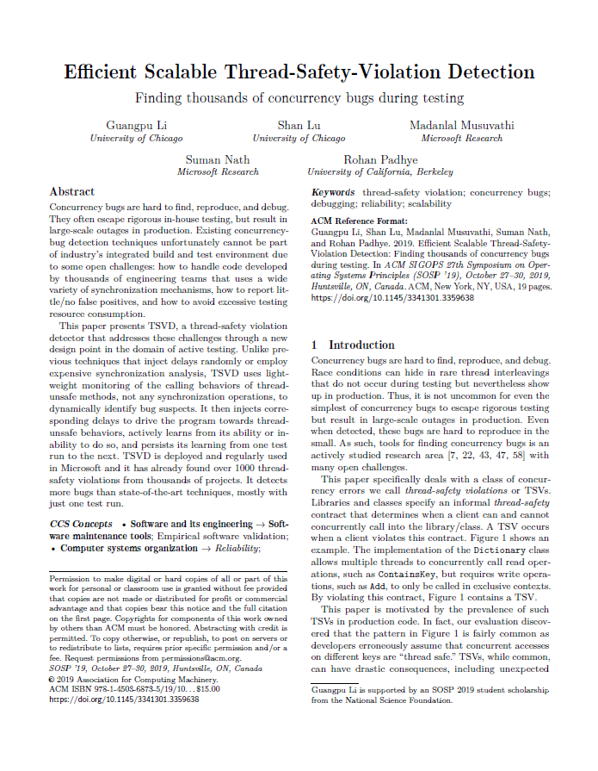
More TSVD details
TSVD likely racing calls
TSVD inference
- Is there exist a synchronization?
Is the program running in a sequential mode?
Is a likely racing call less likely than another?
TSVD multiple runs
Earlier runs’ knowledge will be inherited by later runs

Slide 24


TSVD Review
likely racing list
Operation1 | Opeartion2
Next run
Add
Read
Remove
Thread-safety
contracts
30% overhead
Push-button
0 false positive

Slide 25
TSVD
Motivation
TSVD design
Evaluation
Conclusion

Slide 26
Overall Results
Thread safety contract:
14 system classes (i.e. List, Dictionary)
Test in Microsoft:
1.6K projects, run 1 or 2 times, 1134 TSVs.
Validation:
96% unknown, 47% causing severe customer facing issues

Slide 27
Comparison with other techniques
1K software components, 3K+ unit tests
Random, datacollider, and HB-tracking

Slide 28
Comparison with other techniques
All tools combined
TSVD
HB-analysis
DataCollider
Random delay injection

Slide 29
TSVD
Motivation
TSVD design
Evaluation
Conclusion

Slide 30
Conclusion
TSVD is a push-button TSV detection tool.
TSVD infers synchronizations and uses them in the same run.
Easy integration: oblivious to synchronization patterns
Lightweight: 30% overhead
Accuracy: 0 false positives
Coverage: better than HB-based detection tools
https://github.com/microsoft/TSVD

